Slide 1
Text Analytics
File created on: 4/9/25 12:26:08 PM PDT

Slide 2
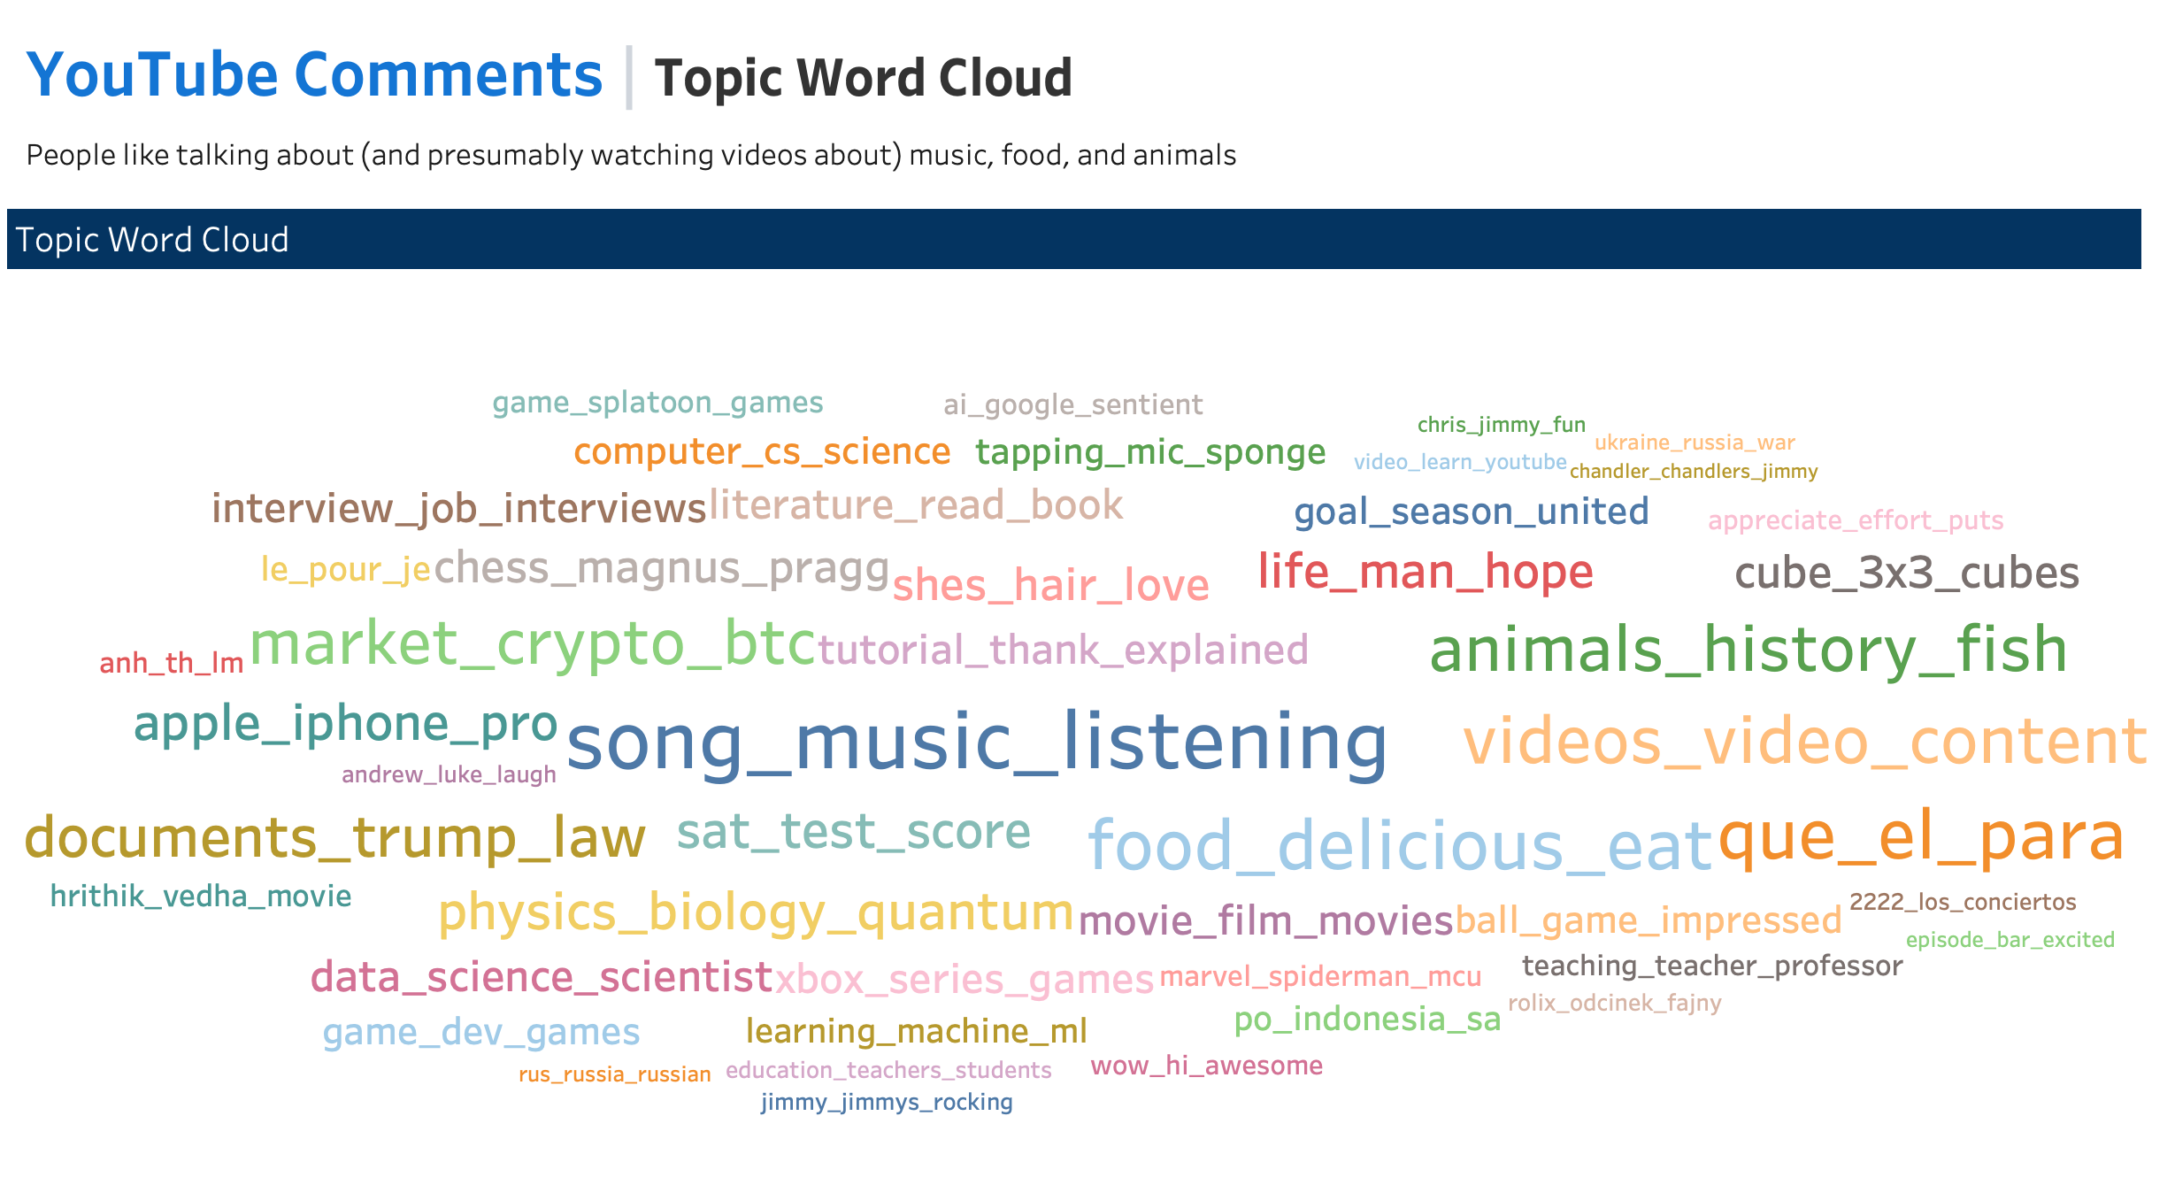

Slide 3
